Slide 1
Operators in Shell Script
Sujan P
Mohammeed Asraff Ali
Mahesh Parikipandla
Sujana SR
Manavi J M
Suresh H S
Anudeep
Farvej H Kulmi

Slide 2
Arithmetic Operators
Arithmetic Operators are used to perform normal arithmetics / mathematical operations.
There are 7 arithmetic operators:
Addition (+): Binary operation used to add two operands.
Subtraction (-): Binary operation used to subtract two operands
Multiplication (*): Binary operation used to multiply two operands.
Division (/): Binary operation used to divide two operands.
Modulus (%): Binary operation used to find remainder of two operands.
Increment Operator (++): Unary operator used to increase the value of operand by one.
Decrement Operator (–): Unary operator used to decrease the value of a operand by one

Slide 3
Method 1
Sum=$((10+3))
echo "Sum = $Sum"
Method 2
((Sum=10+3))
echo "Sum = $Sum"
Method 3
Num1=10
Num2=3
((Sum=Num1+Num2))
echo "Sum = $Sum"
Method 4
Num1=10
Num2=3
Sum=$((Num1+Num2))
echo "Sum = $Sum"

Slide 4
x=8
y=2
echo "x=8, y=2"
echo "Addition of x & y"
echo $(( $x + $y ))
echo "Subtraction of x & y"
echo $(( $x - $y ))
echo "Multiplication of x & y"
echo $(( $x * $y ))
echo "Division of x by y"
echo $(( $x / $y ))
echo "Exponentiation of x,y"
echo $(( $x ** $y ))
echo "Modular Division of x,y"
echo $(( $x % $y ))
echo "Incrementing x by 5, then x= "
(( ++x ))
echo $x
echo "Decrementing x by 5, then x= "
(( --y ))
echo $y

Slide 5
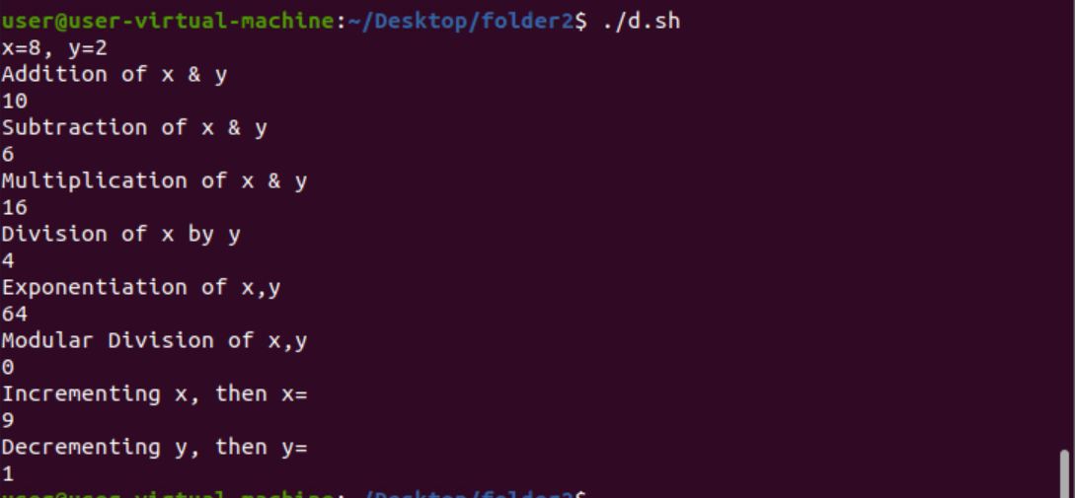

Slide 6
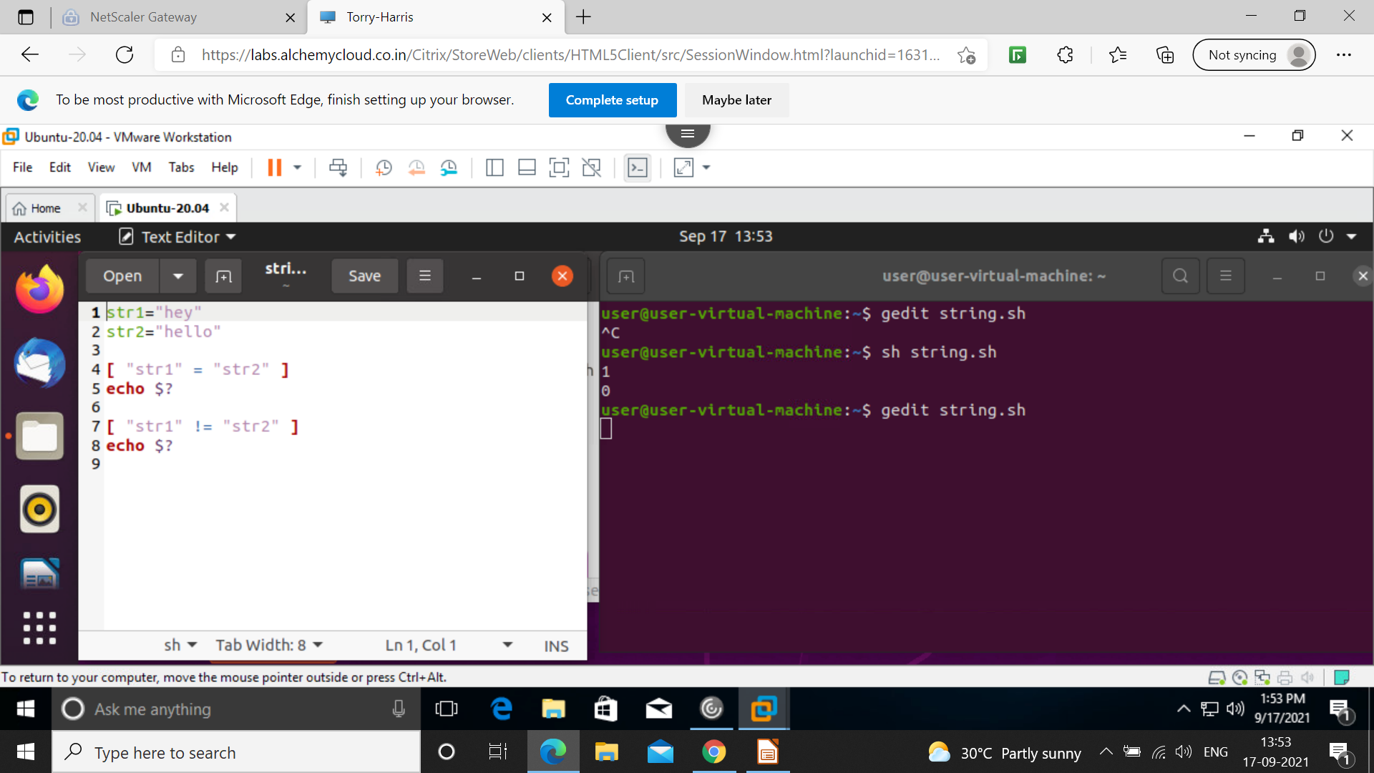
String operator 1)equal to[=]
2)not equal to[!=]
3) -z
4)-n

Slide 7
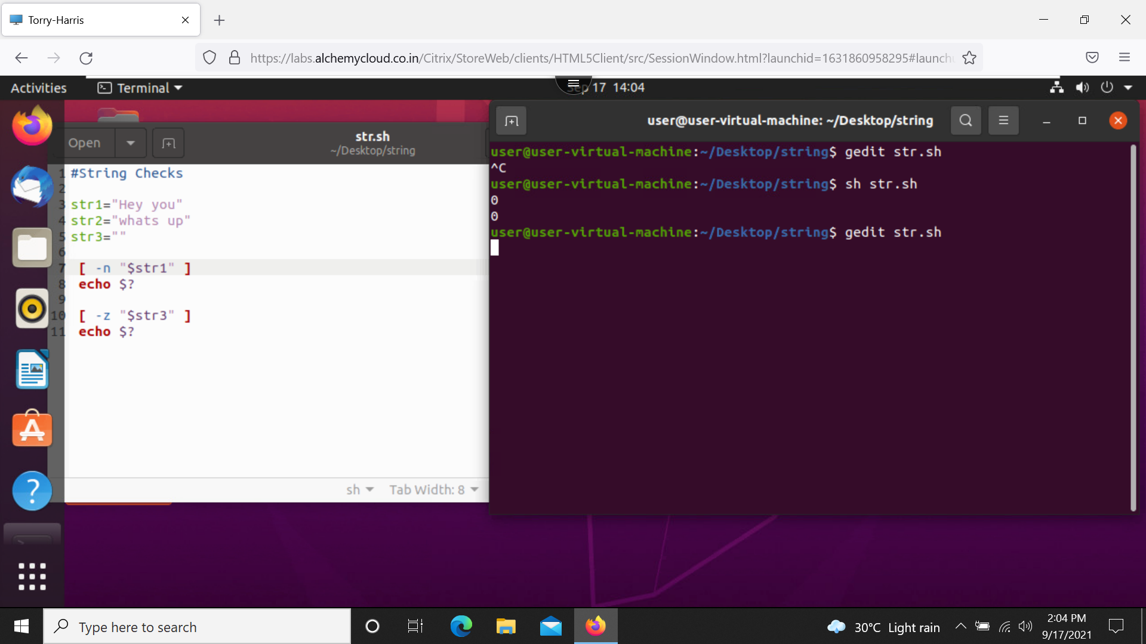
String operator

Slide 8
Bitwise Operators
Bitwise And (&)
Bitwise OR (|)
Bitwise XOR (^)
Bitwise complement (~)
Left Shift (<<)
Right Shift (>>)

Slide 9
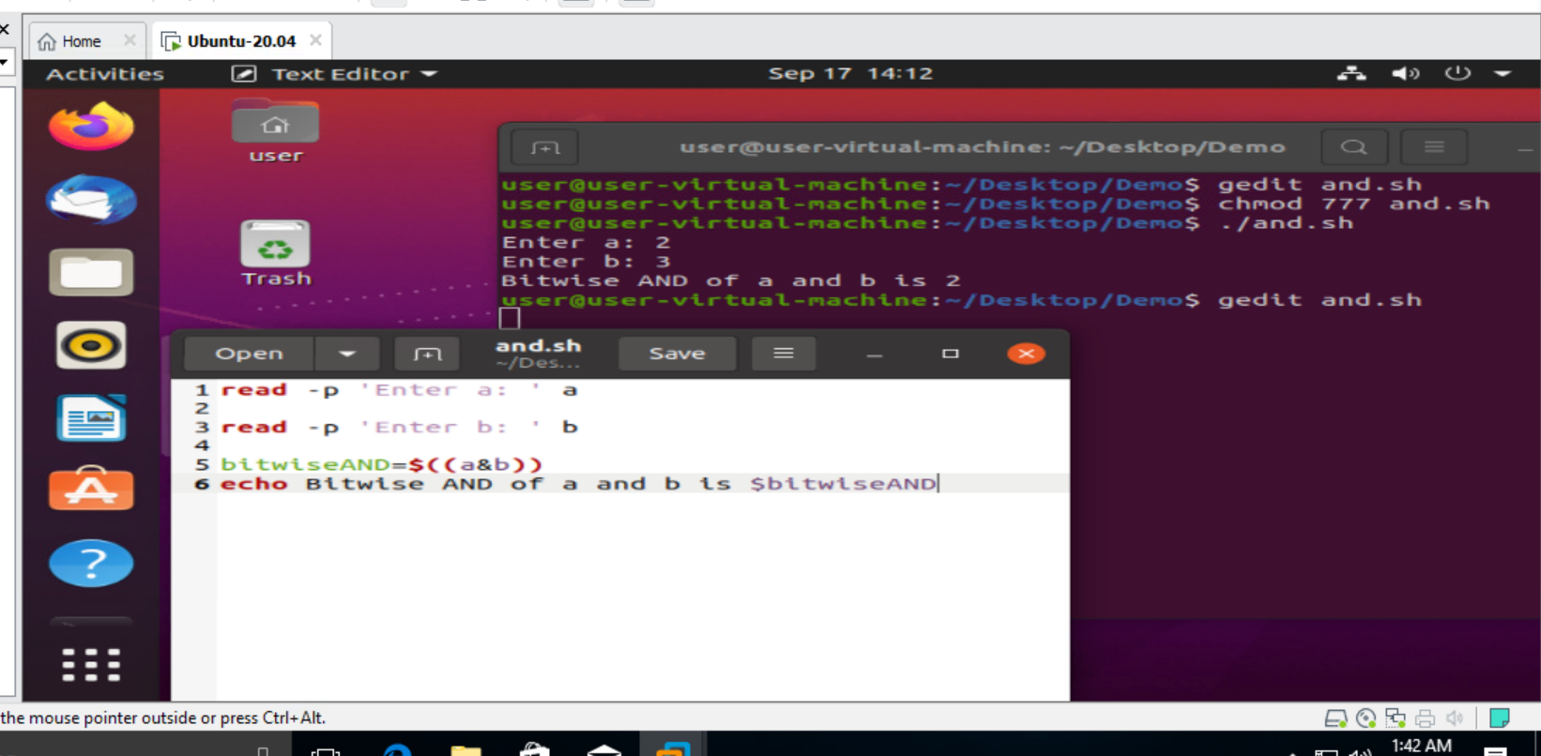
Bitwise AND (&) is the operator that does the binary AND operation on the bits of the operands i.e. each bit of first variable is operated with respective bit of second operator.

Slide 10
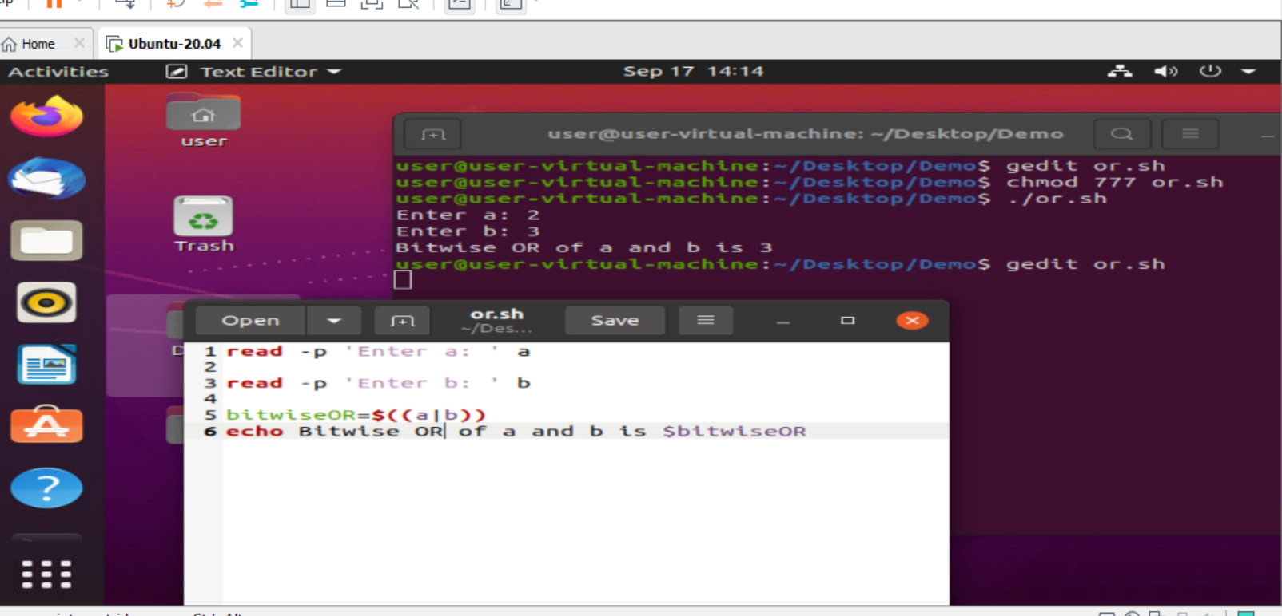
Bitwise OR (|) is the operator that does the binary OR operation on the bits of the operands i.e. each bit of first variable is operated with respective bit of second operator.

Slide 11
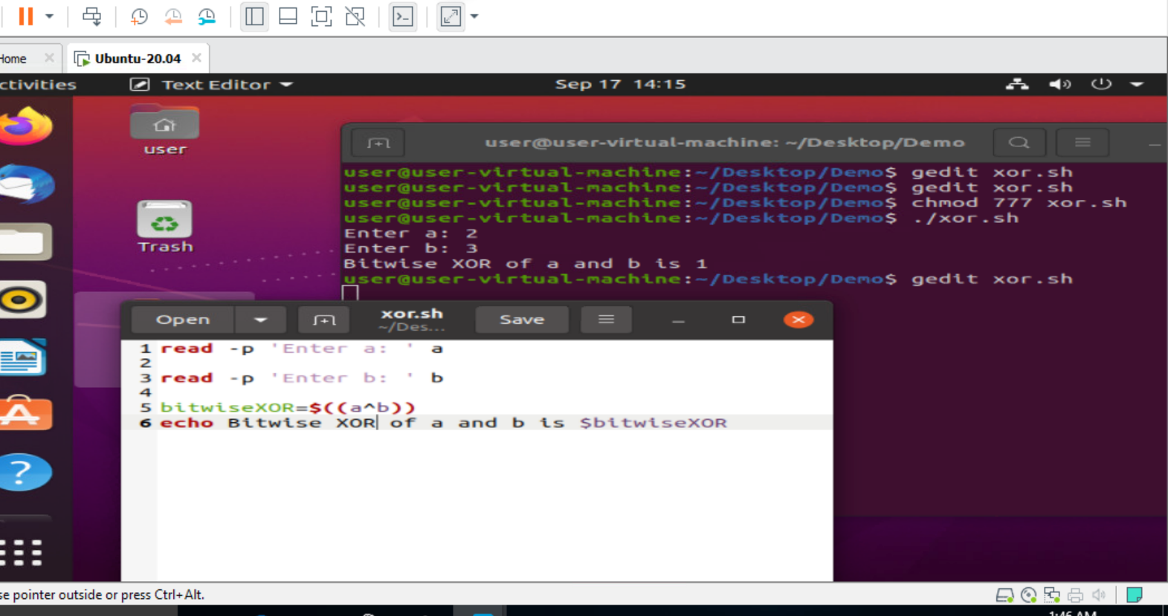
Bitwise XOR (^) is the operator that does the binary XOR operation on the bits of the operands i.e. each bit of first variable is operated with respective bit of second operator.

Slide 12
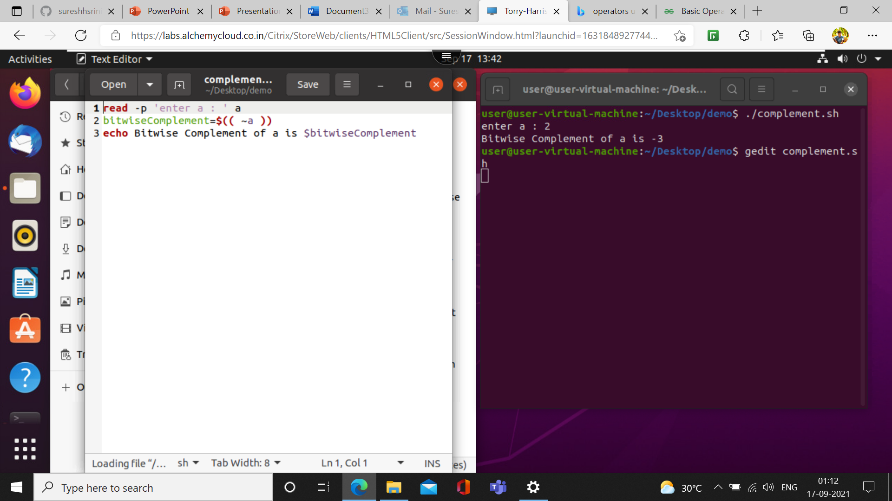
Bitwise Complement(~) Operator
Bitwise ~ operator performs binary NOT operation bit by bit on the operand.

Slide 13
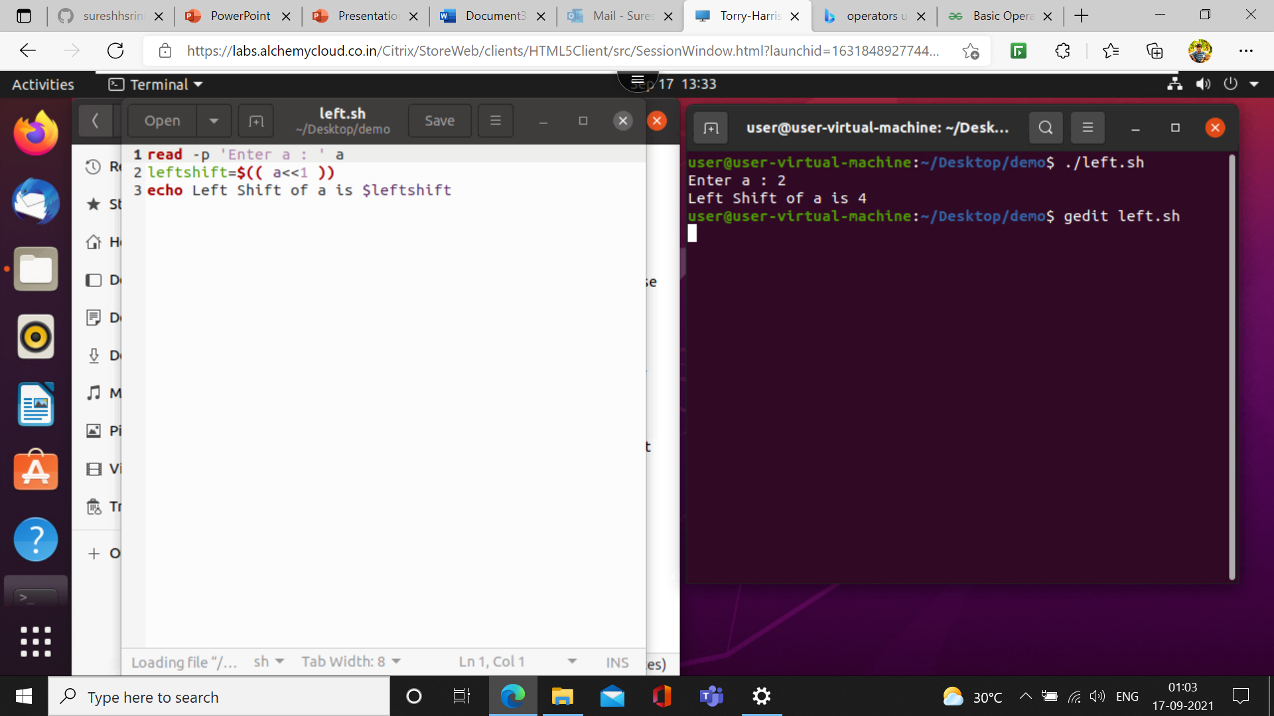
Left Shift (<<) Operator
This operator shifts the bits of the left operand to left by number of times specified by right operand.

Slide 14

Right Shift (>>) Operator
This operator shifts the bits of the left operand to right by number of times specified by right operand.

Slide 15
File Test Operators
We have few file operators which is used to test various properties associated with a Unix file.
Types of file operators:
-r : to check the read access of the file.
-w : to check the write access of the file.
-x : to check the execute permission of the file.
-f : type of file.
-d : whether directory or not.
-s : file size.
-e : existence of file

Slide 16
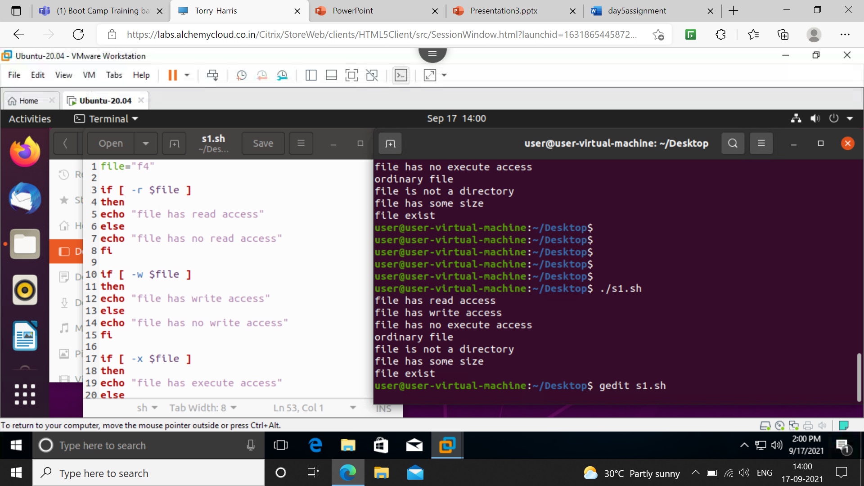
File Test Operators

Slide 17
Logical Operators
They are also known as boolean operators. These are used to perform logical operations. There are of 3 types:
Logical AND (&&)
Logical OR (||)
Not Equal to (!)

Slide 18
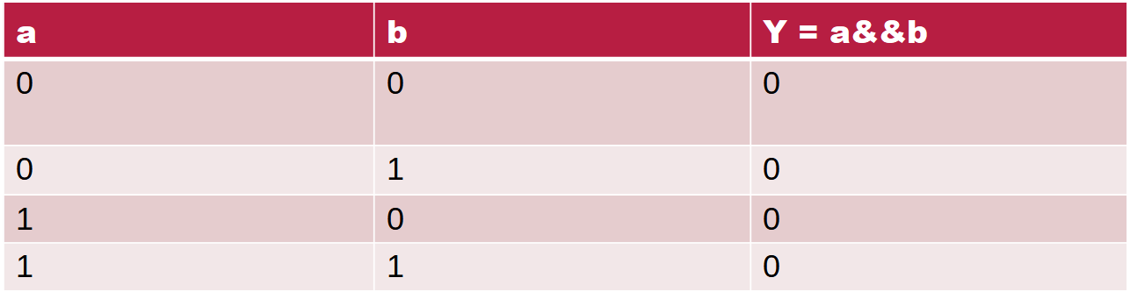
Logical AND (&&)
This is a binary operator, which returns true if both the operands are true otherwise returns false.

Slide 19
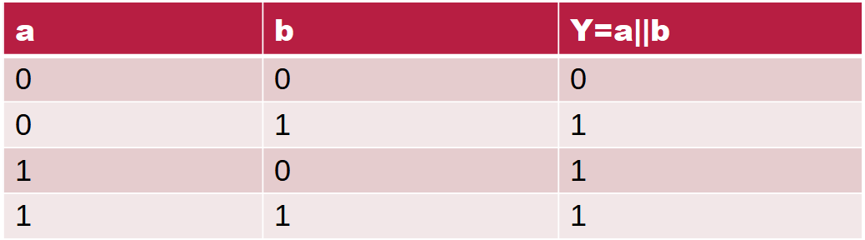
Logical OR (||)
This is a binary operator, which returns true is either of the operand is true or both the operands are true and return false if none of then is false.

Slide 20
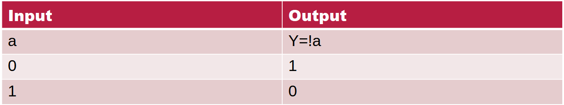
Not Equal to (!)
This is a unary operator which returns true if the operand is false and returns false if the operand is true.

Slide 21
